Slide 1
Travelling Salesman Problem
Seth Roper | Max Mancini

Slide 2
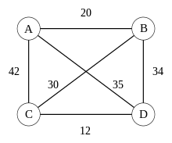
What is the Travelling Salesman Problem

Slide 3
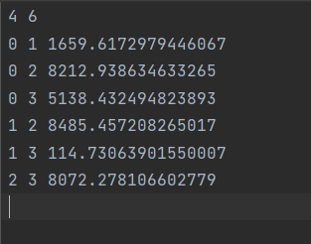

Example inputs and outputs

Slide 4
Use cases for this problem
GPS routing
Musicians touring
CPU chip design

Slide 5
Why the traveling Salesman problem is NP
Transform to a decision problem. Does a Hamilton cycle exist of size k or less?
Take the solutions path and sum the vertexes
Is the sum less than size k?

Slide 6
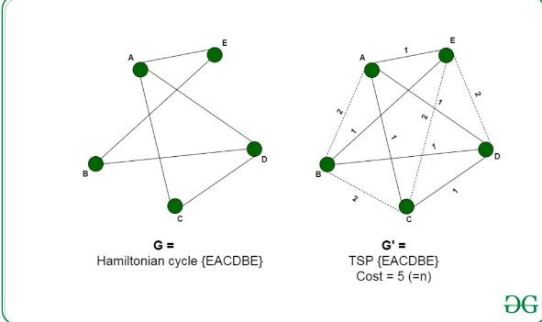
Reducing the Hamilton Cycle Problem to the Travelling salesman problem

Slide 7
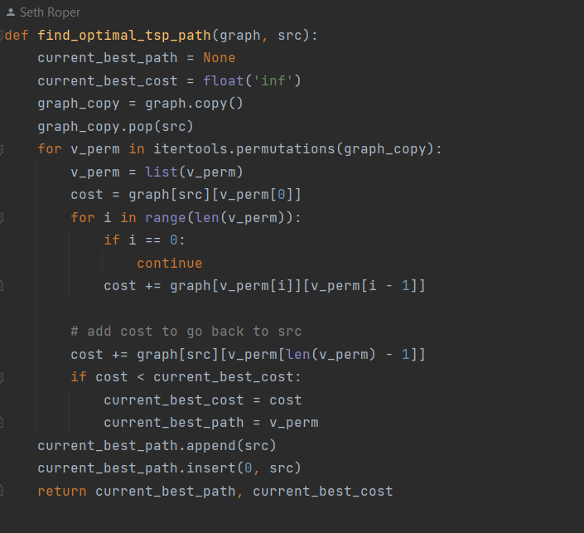
Brute Force Solution

Slide 8
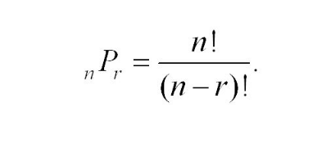
Big O Complexity

Slide 9
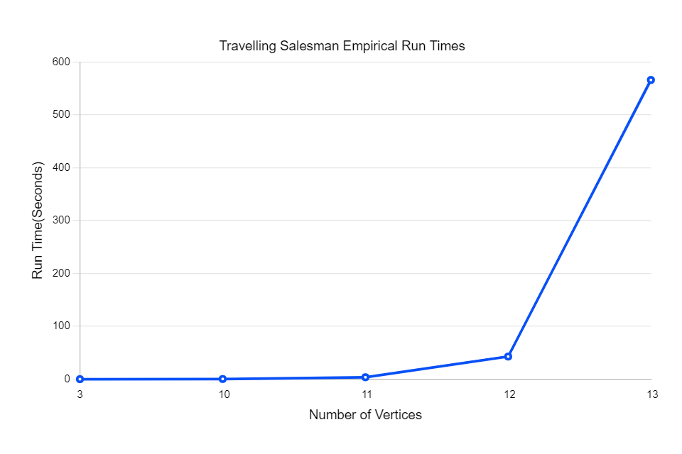
Empirical Run Time

